Slide 1
TBSC Safety Briefing
2026

Slide 2
Commodore’s Annual Newsletter 2026
“… rescue can be intimidating but courses are invaluable. They teach seamanship, how to react in tricky conditions … how to look for and avert difficulties … learn about the tides, the dangerous rocks, the channels between them
It diminishes the danger when the wind erupts or the fog rolls in, and you can potentially save a call-out for the RNLI”

Slide 3
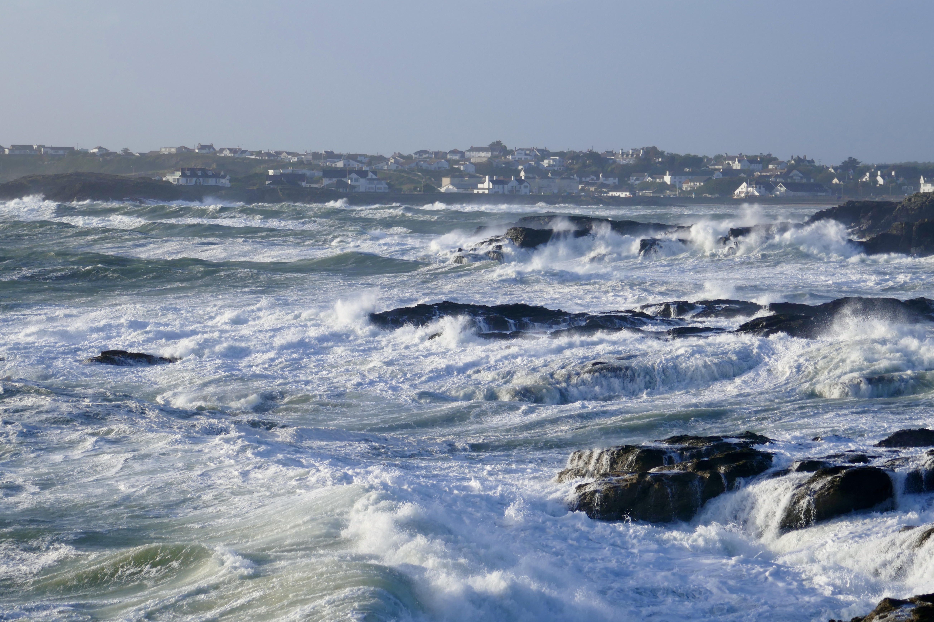
“… when the wind erupts”

Slide 4
RYA Youth Nationals, April 2025
“A sudden and rapid weather change resulted in high winds
Event’s designated rescue boats became overwhelmed by the number of young sailors requiring assistance
Initial reports indicated 15 people were unaccounted for
One adult safety crew sustained a head injury”

Slide 5
In Trearddur Bay
Sea state is primary cause
Repeated capsizing
Inversion & entrapment
Injury
RIB handling error, potential propellor strike

Slide 6
Look at primary risks
Propellor Strike
Medical Emergency
Entrapment … unaccounted for …
And … “how to react in tricky conditions” … and practical tips

Slide 7
1. Propellor Strike
Near miss – RIB drove over capsized dinghy
Probability low, consequences catastrophic

Slide 8
RIB - safe handling
“One hand steer, one hand gear”
Manoeuvre: “Brain – steer – gear - throttle”
Close quarters: “Steer – gear – neutral – steer – gear”
Turn off engine when recovering people from water

Slide 9
2. Medical Emergency
Beaumaris RC, Longboat rower became ill
Coxed to nearest Safe Haven
Location VHF Blackspot = mobile phone 999
Doctor & Ambulance … heart attack
Comms with “Flagstaff” … problem

Slide 10
TBSC
Medical emergency procedure

Slide 11
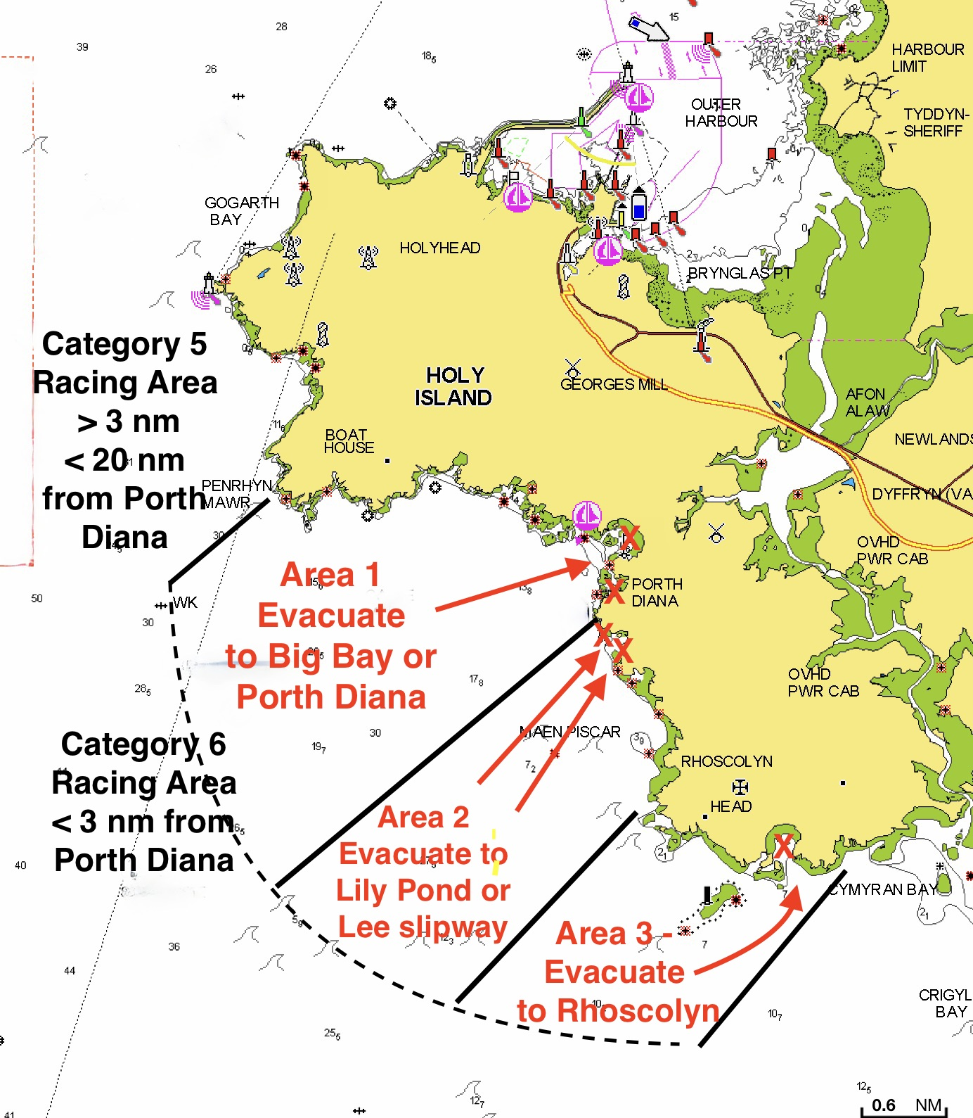
“Scoop and run” to nearest Safe Haven
Life threatening condition = Channel 16
“Mayday, Mayday, Mayday”
Non-emergency, inform Flagstaff nature of injuries – VHF relay if Blackspot
Area 1, land at RNLI slipway

Slide 12
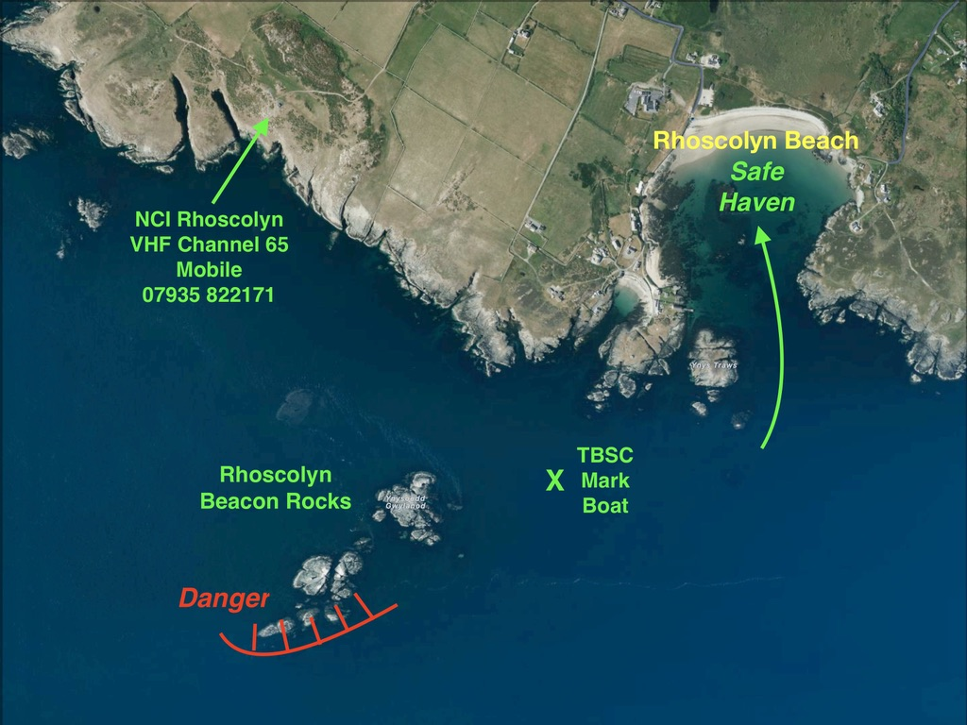
Area 3 Safe Haven

Slide 13
3. Avert difficulties

Slide 14
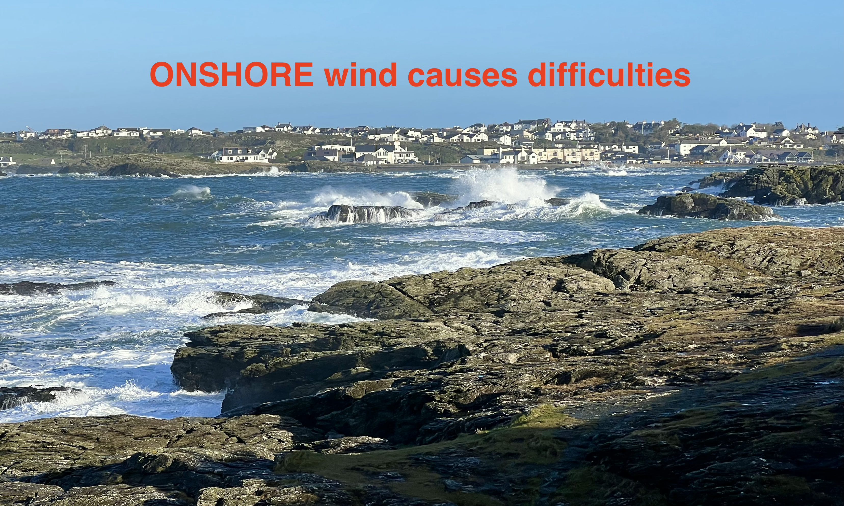

Slide 15
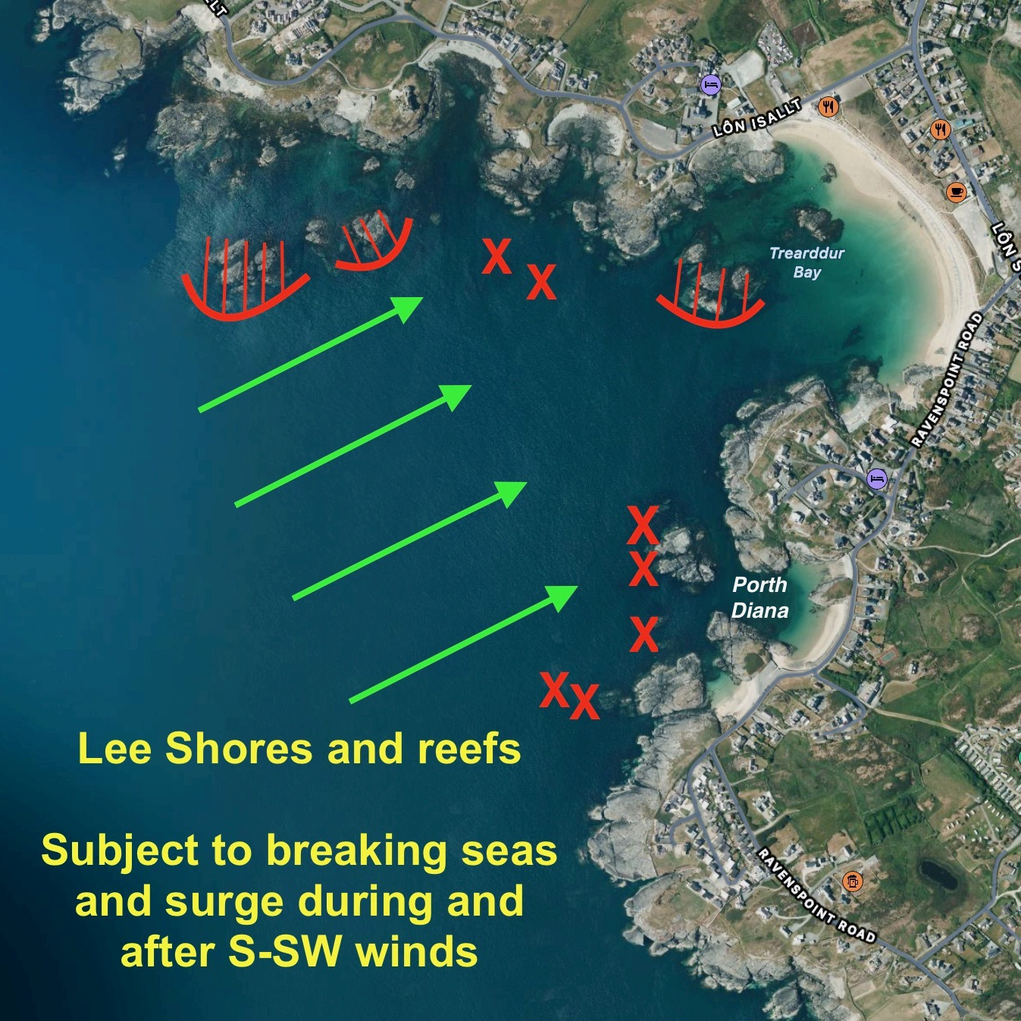
Onshore wind =
Lee Shore
… Lobster pot ropes!
Ebb tide creates tide rip Ravenspoint to Deadmans

Slide 16
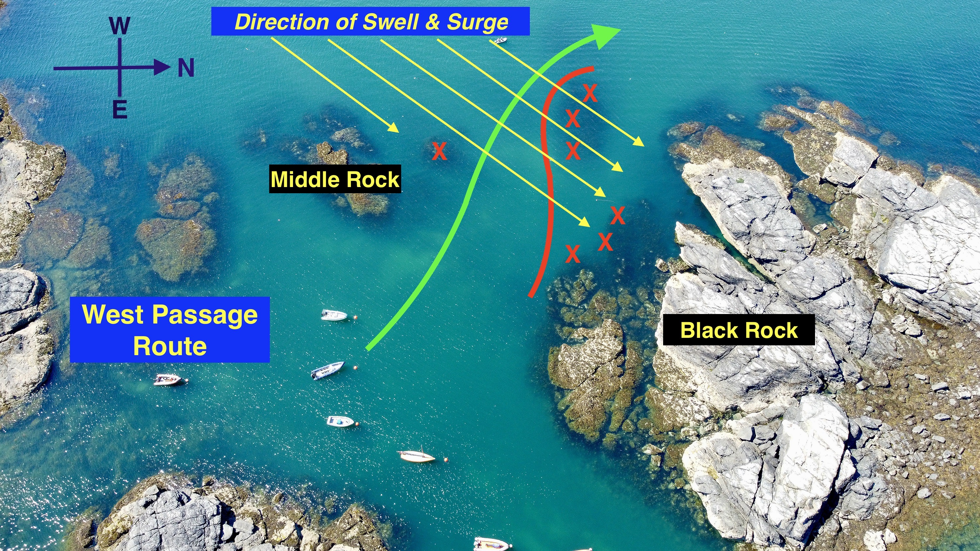

Slide 17
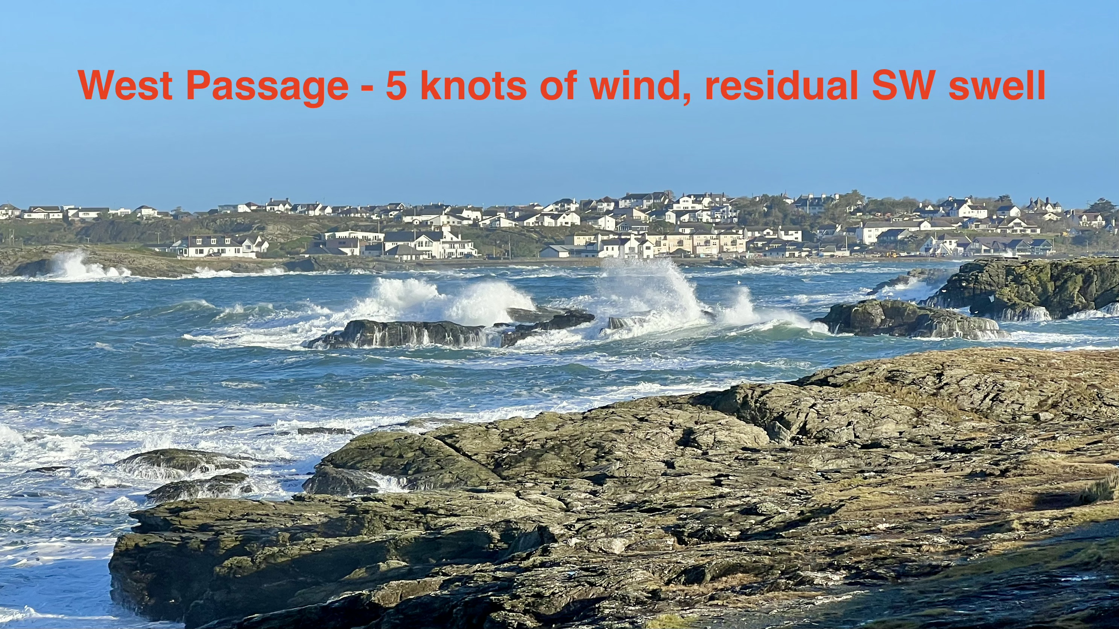

Slide 18
  Classes most at risk
  38x RS Fevas & 28x RS200s
    Risk of inversion & entrapment
    Low probability, high/catastrophic consequence
    Masthead float reduces probability
  49x Myths
    Risk fill & swamp, carried onto rocks
    Medium probability, medium/high consequence
    Buoyancy bags reduce probability

Slide 19
  Entrapment
  RS400 crew’s leg tangled in Half Rater main sheet
  Inverted dinghy, first RIB attending, crew headcount
    Release trapped crew … enter water if necessary
    If injury, scoop & run to nearest safe haven
    VFH comms with Flagstaff
  Pre-departure, knife to hand, wire cutters from rescue bucket

Slide 20
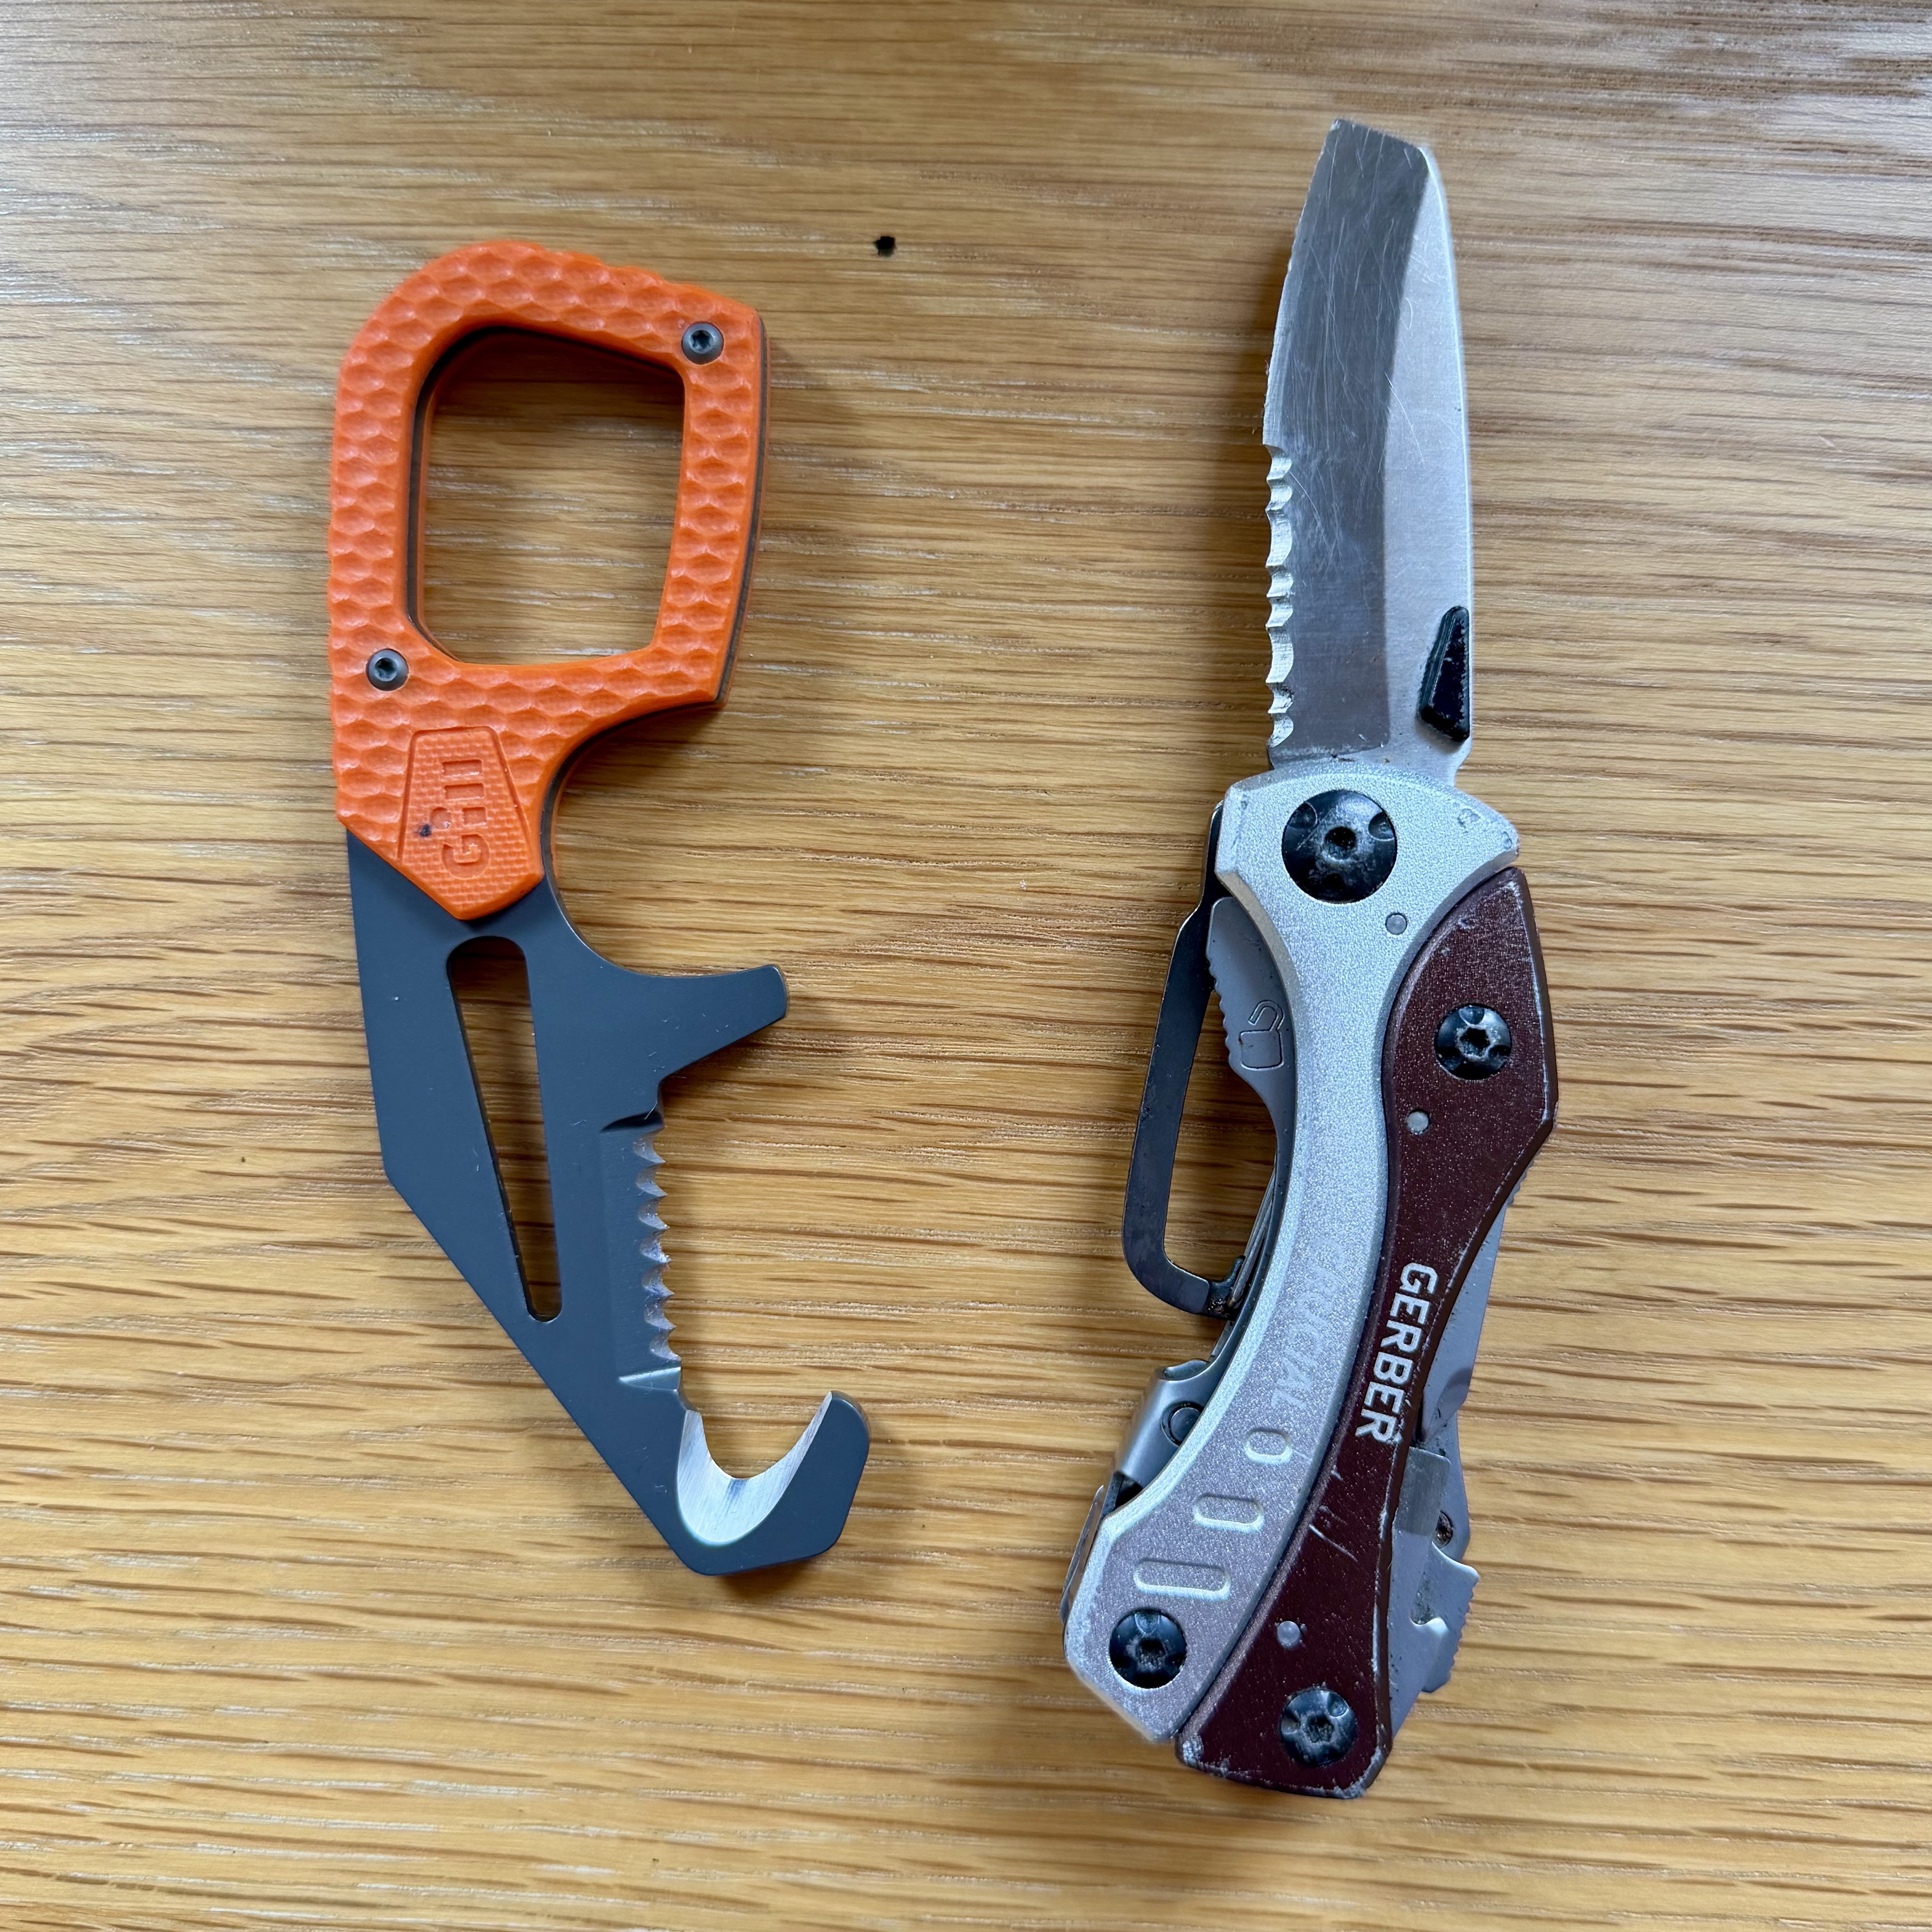
  Recommend all sailors and rescue crew wear a personal rescue knife attached to their PFD or belt – able to cut Dyneema or Spectra

Slide 21
Crew tired/cold? Shock?
Instruct dinghy crew to board RIB
  Assess condition
  If abandoning dinghy, report Sail Number to Flagstaff
  Take crew ashore
Recover dinghy?
  Not priority during racing

Slide 22
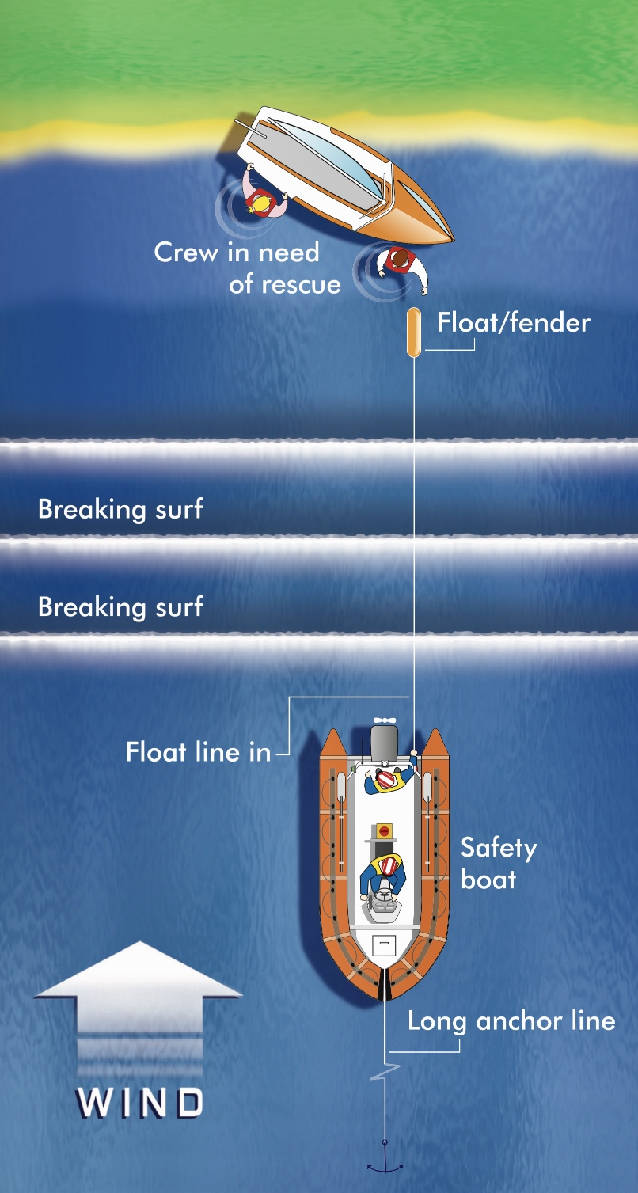
Crew on Lee Shore rocks
Professional Safety Boat crews or RNLI
Most likely a Myth on Lagoon or Cod Rocks …
Risk of crew injury lower leg, arms
Safety RIB position upwind, deploy anchor
Engine in neutral
Let out anchor line, stay clear of outlying rocks
Throw-bag heaving line
Pull crew to Safety Boat
TURN ENGINE OFF
Recover dinghy crew

Slide 23
Righting inverted RS in seaway
Advanced RIB handlers only
Take crew into RIB … downwind side
Position RIB upwind, stern to waves, hold station in reverse gear
Attach 2 ropes
    One from bow of RIB to bow of RS
    Pass other across hull attach to righting line or jib sheet
    May need 2nd RIB to assist

Slide 24
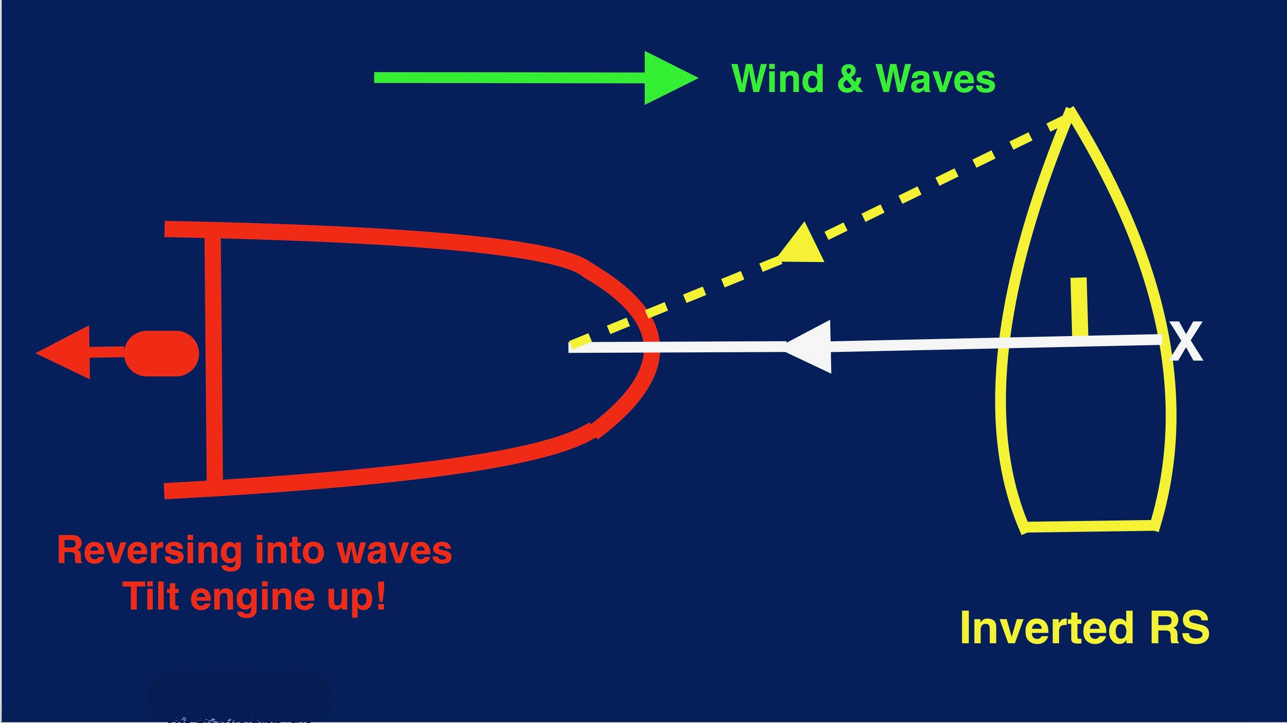

Slide 25
Advice
  When first checking in with Flagstaff, RIB helm report engine Kill Cord is attached to their leg
  Kill Cord worn at all times
  RS Feva main halyard cleated at top of mast, if capsized rescue crew release halyard or cut it
  If dinghy capsized with Spinnaker up, rescue crew hold top of mast to prevent inversion whilst crew untangle Spinnaker and lines

Slide 26
Reminders
Wear PFDs and gloves
Constant 360 lookout
Risk of swamping reversing into waves
  Depends on RIB’s design
  Trim engine up before reversing!
Towing astern
  Sails down, centreboard up, crew weight aft & steering

Slide 27
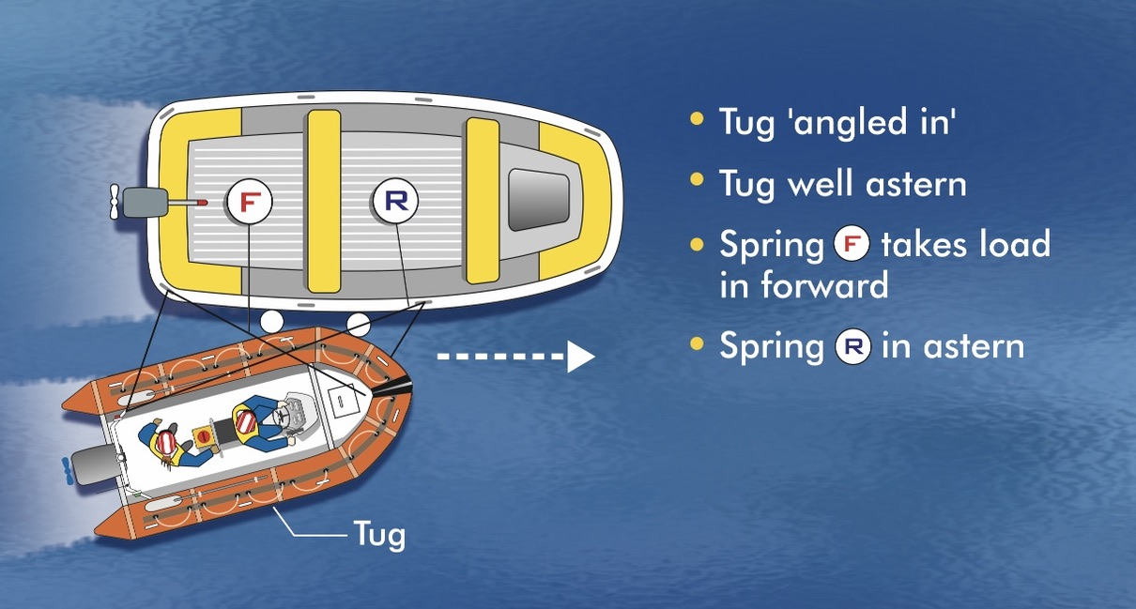
Towing alongside for control and close quarters manoeuvring of heavy or partially filled boat

Slide 28
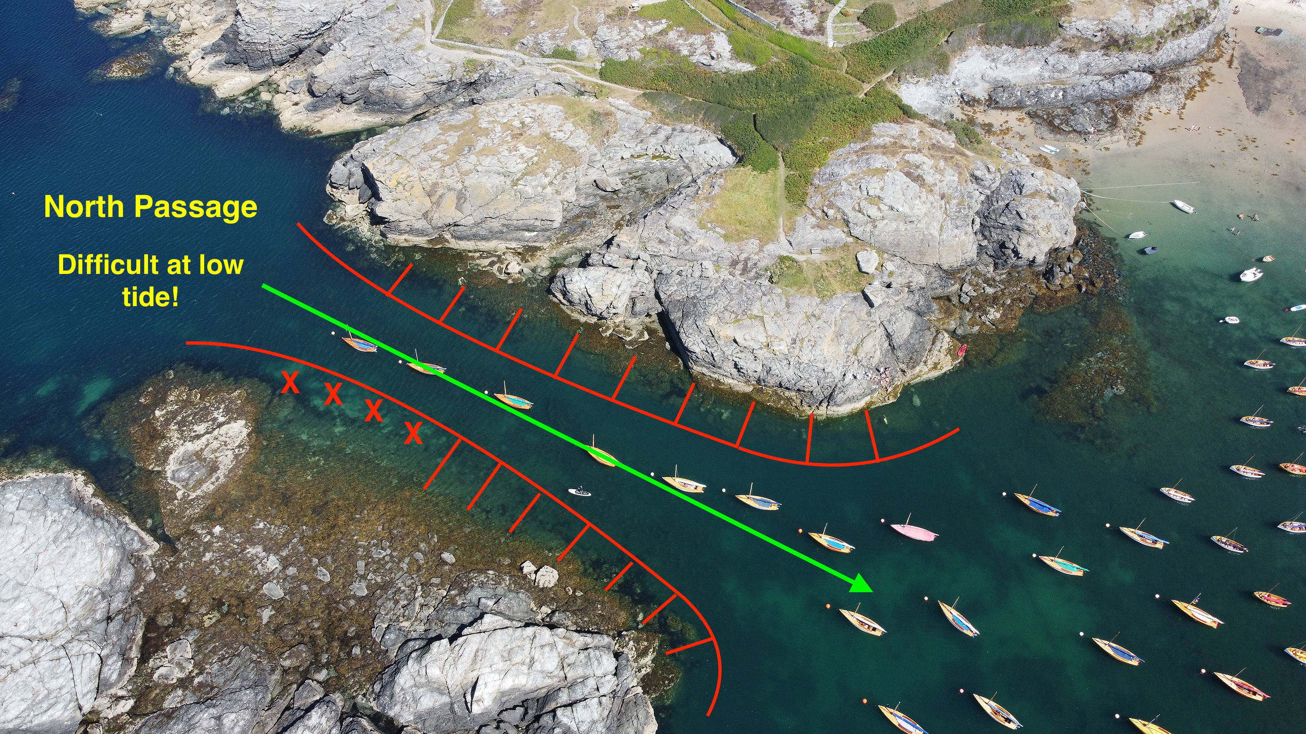

Slide 29
Engine failure … rescue RIB?
Contaminated fuel
Kill Cord or isolator switch overboard
Lobster pot rope round prop

Slide 30
Pre-departure check list
Test or check: VHF operation, anchor ready, pump and buckets, MoB recovery method, first aid kit, knife, wire cutters, fire extinguisher, drinking water…
Arrangements for towing astern and alongside
Crew briefing and emergency procedures

